Slide 1


Inventors Program
Analyzing the Best Fracker
Vee Lee Koh (PGE), Kushal Pachchigar (CS),
Anjali Sridharan (ChemE), Kaylee Trevino (ECE)

Slide 2
Presentation Flow
Problem Statement
Efficiency Metrics
Principal Component Analysis
Conclusion

Slide 3
Problem Statement
Finding out, at any given moment, which one of the 5 Eagle Ford frac crews is the best performer
Creating an equitable ranking system

Slide 4
How Did we Define “Best” Fracker in Our Analysis?
Efficiency metrics:
Average Pump Time
Time Interval between Stages
Mobilization Time
Demobilization time
Grouped by:
Service Company
Project Type (Initial Completion vs Recompletion)
Well

Slide 5
Number of Wells by Service Company
Service Company | # Completion Wells | # Recompletion Wells
A (04) | 192 | 28
B (05) | 67 | 12
C (07) | 8 | 1
D (03) | 33 | 7
E (02) | 87 | 10

Slide 6
Average Pump Time
Average Time to Pump Each Stage /
10 MM lbs Proppant / 10 MM bbl Fluid
Assumptions: Only considered stages which pumped more than 500 lbs proppant, 500 bbl fluid and 12 stages; Fluid and proppant type neglected

Slide 7
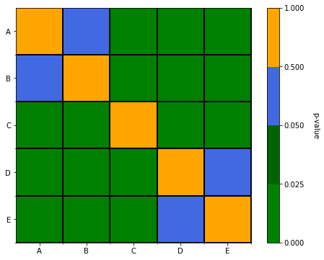
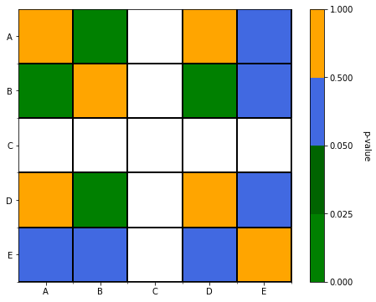
Completions
Recompletions
P-value
P-value
t-test Hypothesis Testing: Average Pump Times by Company
Notes:
Using t-test for hypothesis testing as we're comparing the means of average pump time distributions of different companies. Due to some companies having less data (n<30), t-test is suitable. t-test also approaches z-test as number of data increases.
t-test assumes Gaussian distribution but data doesn't look Gaussian
Performed Bootstrap to prove that data approaches Gaussian with resampling (Central Limit Theorem)
Assume unequal variance
Two tailed test with 95% confidence

Slide 8
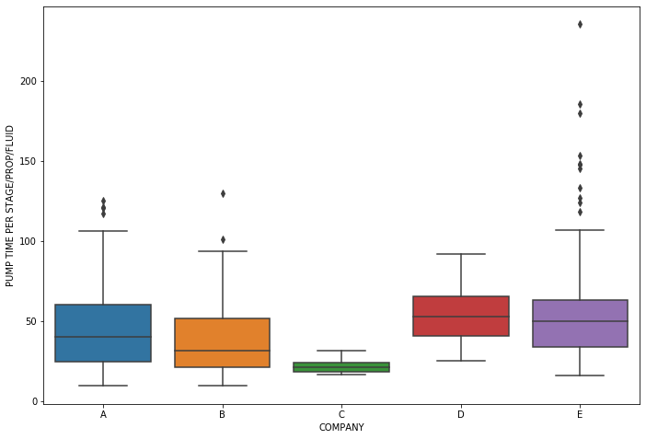
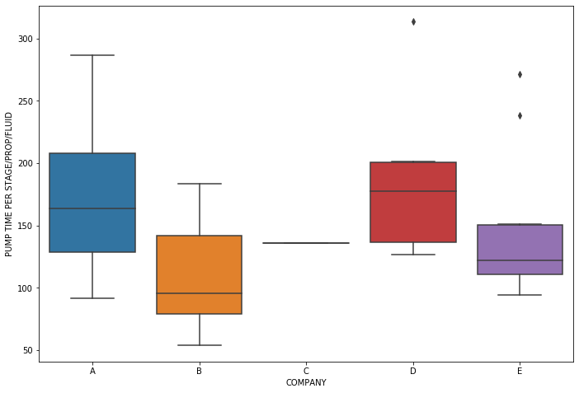
Results
Average Pump Time for Initial Completions
Average Pump Time for Recompletions

Slide 9
Time Interval Between Stages
Assumption: Diversion method (plug type) neglected

Slide 10
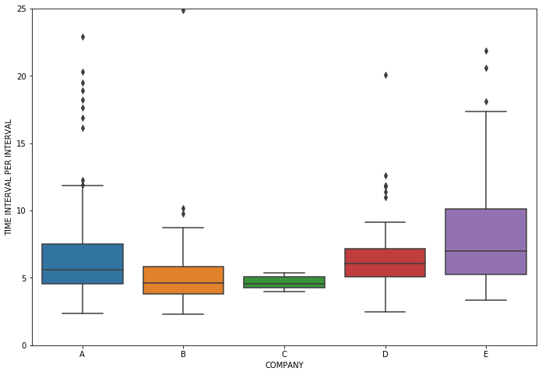
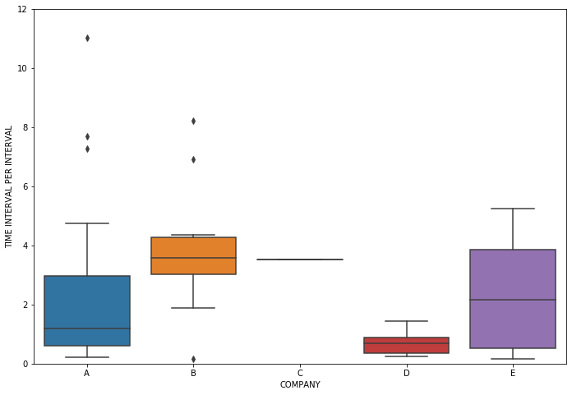
Results
Time per Interval for Completions
Time per Interval for Recompletions

Slide 11
Mobilization Time
Assumption: Filter out times greater than 1 week

Slide 12
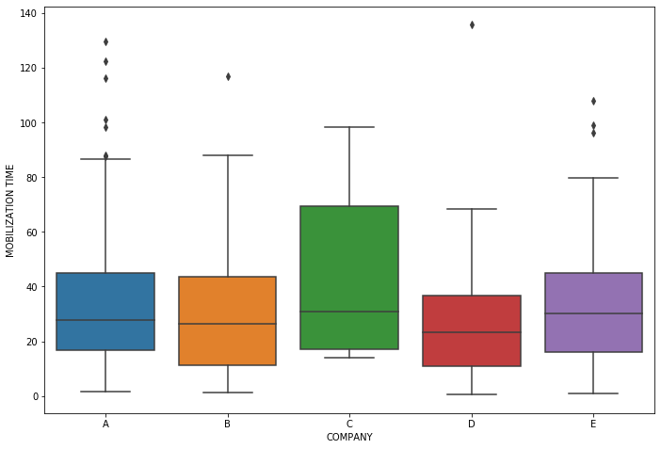
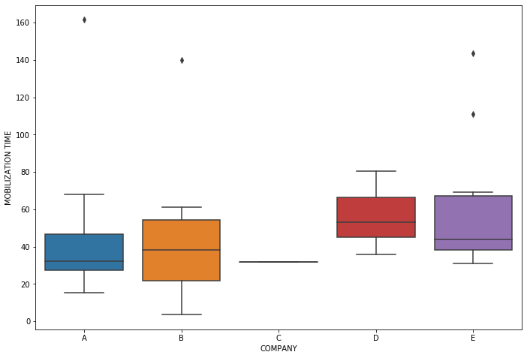
Results
Mobilization Time for Completions
Mobilization Time for Recompletions

Slide 13
Demobilization Time
Assumption: Filter out times greater than 1 week

Slide 14
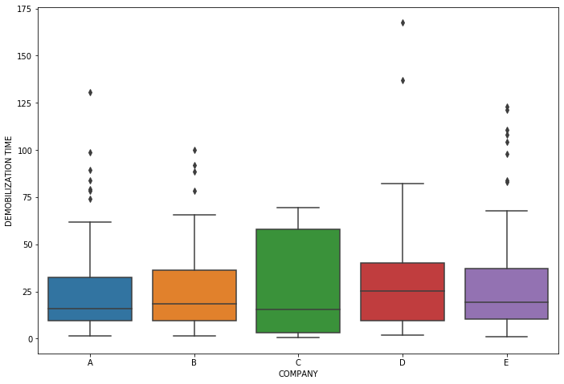
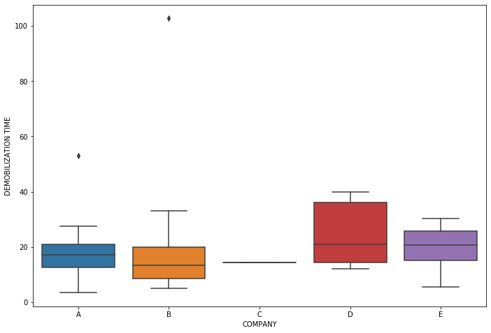
Results
Demobilization Time for Completions
Demobilization Time for Recompletions

Slide 15
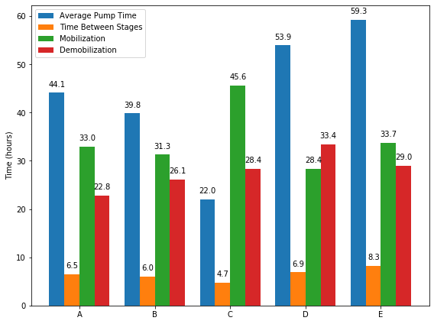
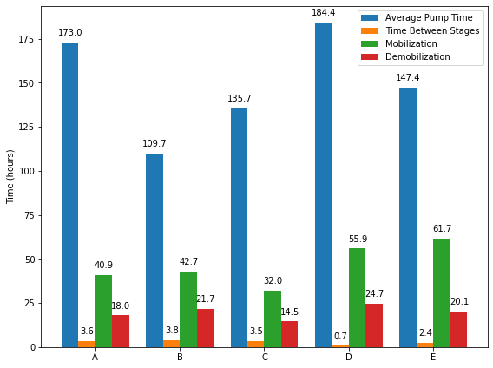
All Metrics by Company
Initial Completions
Recompletion
Notes:
The shorter the time, the better
For Completions, neglecting C (due to limited sampling) A & B perform better in 3 out of 4 metrics than C & D
For Recompletions, neglecting companies which have less than 10 wells (C & D), A, B & E perform best on different metrics
Compare the two projects - Recompletions has higher average pump time than initial completions but shorter time intervals btwn stages

Slide 16
Principal Component Analysis
Combining the four metrics to create an
efficiency score

Slide 17
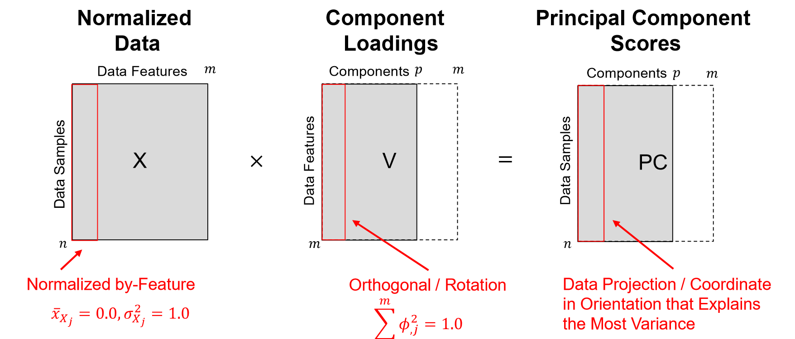
PCA Overview
Credits to Dr. Prycz (PGE) - Figure taken from Subsurface Machine Learning course
Notes:
Standardize metrics
Fit the PCA model with metrics dataframe to get component loadings → analyze to see which metrics strongly influence each PC
Also look at variance explained by each PC → make a decision on which PC to drop to reduce the dimensionality
Product will give me the PC score (Efficiency scores)

Slide 18
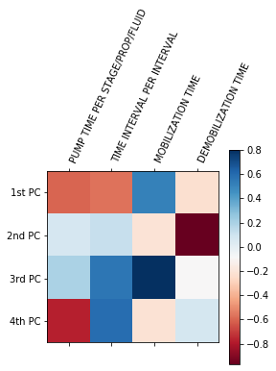
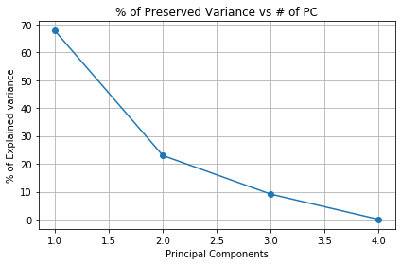
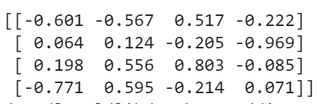
PCA - Initial Completions
Component
Loadings
Scree Plot of Variance Explained
Notes:
% of variance explained by PC1 thru PC4 = [67 23 9 0]

Slide 19
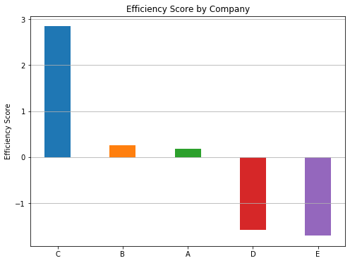
PCA Completions Efficiency Score
COMPANY | # WELL | 1st PC SCORE
A | 192 | 0.175514
B | 67 | 0.264578
C | 8 | 2.841186
D | 33 | -1.575974
E | 87 | -1.705304
The higher the PC score,
the higher the efficiency

Slide 20
Conclusions
EFFICIENCY METRICS | BEST IN INITIAL COMPLETIONS | BEST IN RECOMPLETIONS
AVERAGE PUMP TIME | B, A | B, E
INTERVAL BETWEEN STAGES | B, A | E, A
MOBILIZATION TIME | D, B | A, B
DEMOBILIZATION TIME | A, B | A, E
OVERALL | B & A | A & E
For initial completions, C neglected due to limited sampling
For recompletions,
C & D neglected due to limited sampling
Next steps:
Group by fluid and plug type
Outlier detection of time interval between stages
Perform cost analysis (Efficiency / Cost)

Slide 21
Use Cases for COP

Slide 22
Thank You for the Opportunity!

Slide 23
Appendix

Slide 24
Efficiency Metric Values - Initial Completions
COMPANY | WELL | PUMP TIME PER STAGE/PROP/FLUID | TIME INTERVAL PER INTERVAL | MOBILIZATION TIME | DEMOBILIZATION TIME
A | 192 | 44.138716 | 6.501828 | 32.988421 | 22.769035
B | 67 | 39.820412 | 5.976615 | 31.283333 | 26.147264
C | 8 | 21.997736 | 4.657350 | 45.581250 | 28.381250
D | 33 | 53.946075 | 6.945747 | 28.355556 | 33.392929
E | 87 | 59.284559 | 8.261611 | 33.728544 | 28.989535

Slide 25
Efficiency Metric Values - Recompletions
COMPANY | WELL | PUMP TIME PER STAGE/PROP/FLUID | TIME INTERVAL PER INTERVAL | MOBILIZATION TIME | DEMOBILIZATION TIME
A | 28 | 173.004308 | 3.580470 | 40.930247 | 17.968000
B | 12 | 109.734543 | 3.825480 | 42.718056 | 21.730556
C | 1 | 135.671307 | 3.524603 | 31.950000 | 14.500000
D | 7 | 184.377920 | 0.711492 | 55.913889 | 24.736667
E | 10 | 147.435767 | 2.381388 | 61.708333 | 20.125000

Slide 26
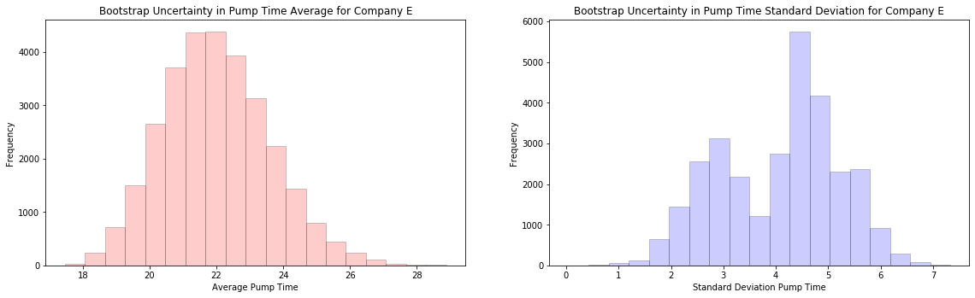
Bootstrap on Company C’s Completions Data

Slide 27
PCA - Initial Completions
What the PC scores translate to:
COMPANY | WELL | 1st PC SCORE | PUMP TIME PER STAGE/PROP/FLUID | TIME INTERVAL PER INTERVAL | MOBILIZATION TIME | DEMOBILIZATION TIME
A | 192 | 0.175514 | 42.474607 | 6.351145 | 34.922656 | 27.799994
B | 67 | 0.264578 | 41.783011 | 6.291528 | 35.194259 | 27.730977
C | 8 | 2.841186 | 21.775244 | 4.566805 | 43.051706 | 25.734319
D | 33 | -1.575974 | 56.075186 | 7.523551 | 29.581439 | 29.157252
E | 87 | -1.705304 | 57.079450 | 7.610121 | 29.187044 | 29.257471

Slide 28
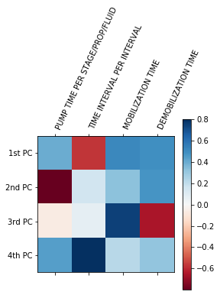

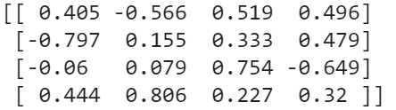
PCA - Recompletions
Notes:
% of variance explained by PC1 thru PC4 = [68 20 7 3]

Slide 29
PCA - Recompletions
What the PC scores translate to:
COMPANY | WELL | 1st PC SCORE | PUMP TIME PER STAGE/PROP/FLUID | TIME INTERVAL PER INTERVAL | MOBILIZATION TIME | DEMOBILIZATION TIME
A | 28 | -0.571049 | 143.894124 | 3.179574 | 43.460807 | 18.832882
B | 12 | -1.024871 | 139.006111 | 3.477503 | 40.930991 | 18.054726
C | 1 | -2.043417 | 128.035585 | 4.146167 | 35.253139 | 16.308253
D | 7 | 2.699430 | 179.119727 | 1.032540 | 61.691998 | 24.440684
E | 10 | 0.939907 | 160.168299 | 2.187648 | 51.883590 | 21.423678

Slide 30
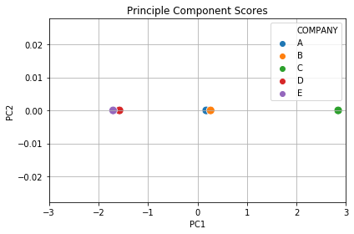
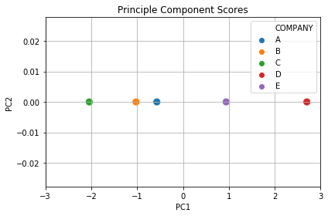
PCA - Completion vs Recompletion

Slide 31
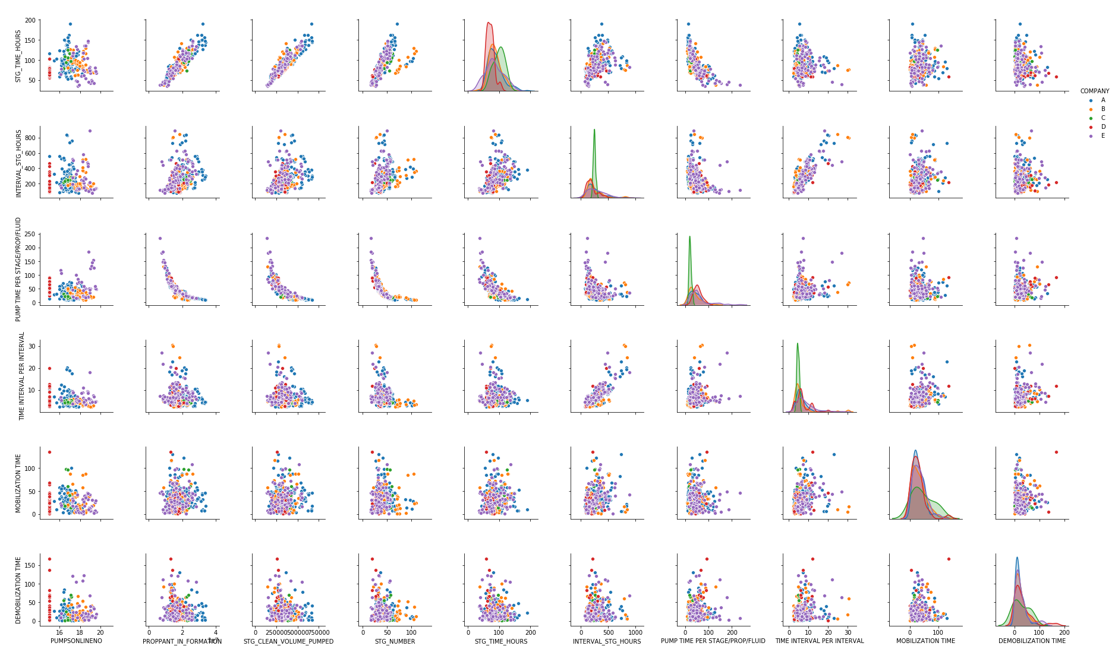
Completions

Slide 32
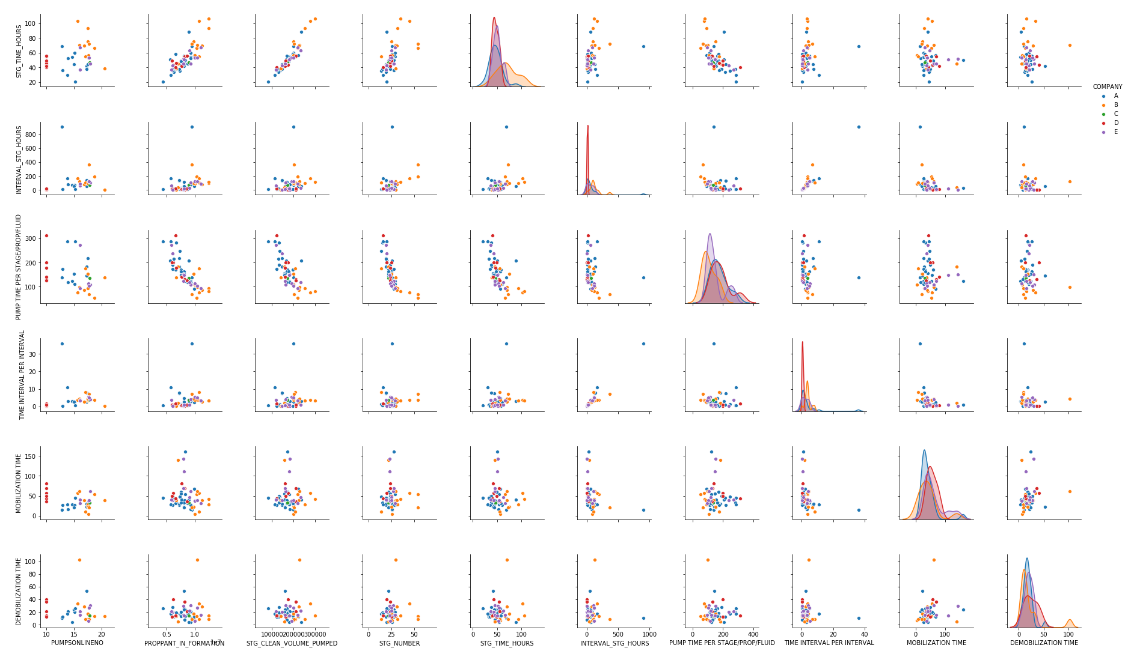
Recompletions

Slide 33
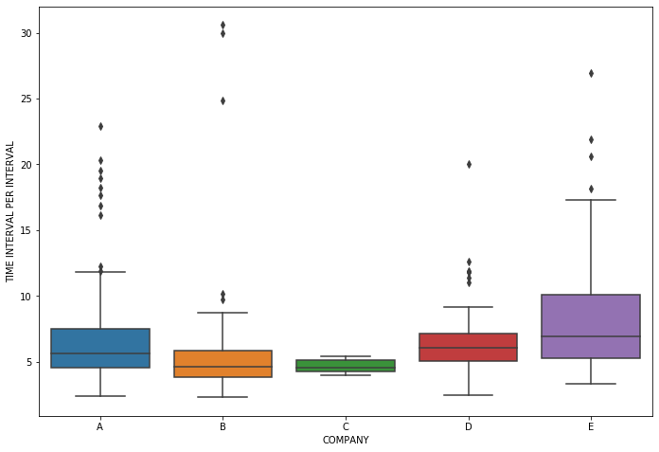
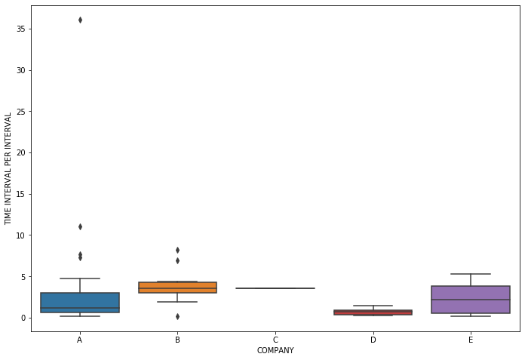
Results for Time Interval Between Stages
Time per Interval for Completions
Time per Interval for Recompletions

